Slide 1


DIGITAL PORTFOLIO !!
STUDENT NAME: THAMIZHARASI. L
REGISTER NO AND NMID: 222403871/asumn293222403865
DEPARTMENT: COMPUTER SCIENCE
COLLEGE: VIDHYA SAGAR WOMENS COLLEGE

Slide 2

PROJECT TITLE
DIGITAL PORTFOLIO
A Digital Portfolio is a personal website that shows who you are, what skills you have, and what projects you did.

Slide 3


AGENDA:
Problem Statement
Project Overview
End Users
Tools and Technologies
Portfolio design and Layout
Features and Functionality
Results and Screenshots
Conclusion
Github Link

Slide 4

PROBLEM STATEMENT
>> The gap or difficulty in the current system that your project solves.
“In today’s competitive world, talent often gets lost in plain resumes. Students with great projects fail to present them effectively, while recruiters waste time searching for the right candidate. Our project solves this communication gap.”

Slide 5



PROJECT OVERVIEW
The project is a Personal Portfolio Website developed in three stages: 1. Basic HTML structure (skeleton).
2. Styled version using CSS.
3. Interactive version using JavaScript.

Slide 6




WHO ARE THE END USERS?
Students → To showcase their projects and skills. Fresher's / Job Seekers → To present their portfolio to recruiters. Employers / Recruiters → To quickly evaluate candidates. General Audience → To know more about the developer.

Slide 7


TOOLS AND TECHNIQUES
1.HTML5 → Structure of the website. 2.CSS3 → Styling, layout, responsive design. 3.JavaScript (ES6) → Interactivity, form validation, smooth scroll. 4.Code Pen → Development & online demo. 5.GitHub → Version control & hosting link.

Slide 8

FEATURES AND FUNCTIONALITY
1.HTML Structure → Header, About, Skills, Projects, Contact, Footer. 2.CSS Styling → Colours, responsive layout, cards, sticky nav. 3.JavaScript → Smooth scroll, mobile menu toggle, form validation. 4.Responsive Design → Works on mobile, tablet & desktop. 5.Contact Section → Email, LinkedIn, phone with functional form.

Slide 9
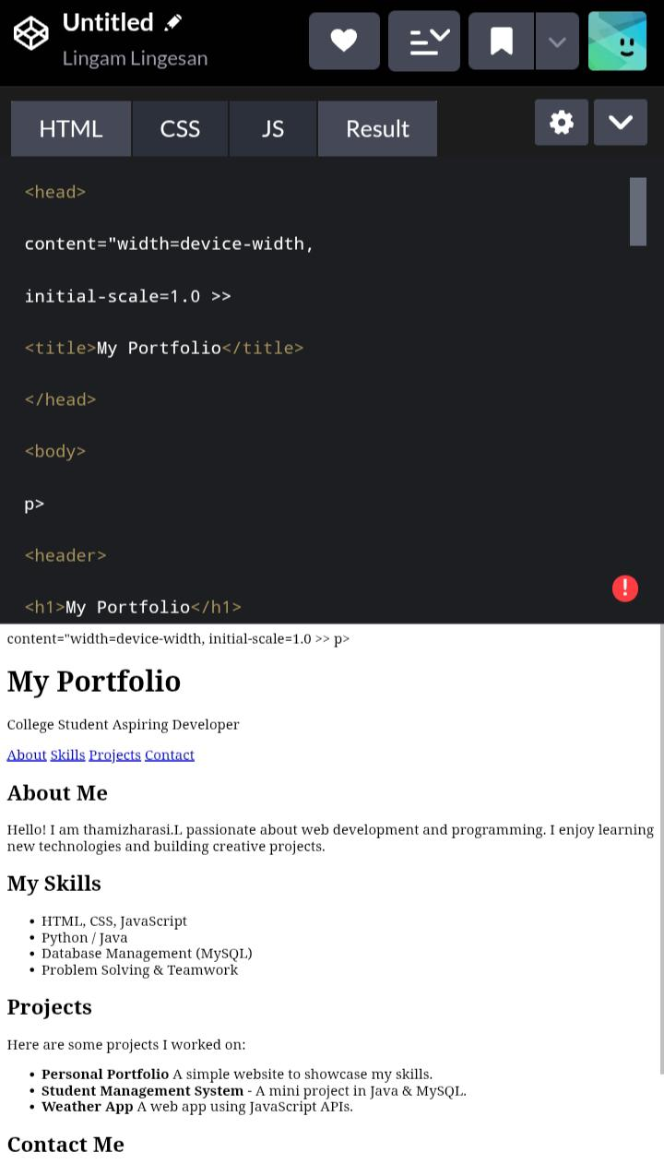

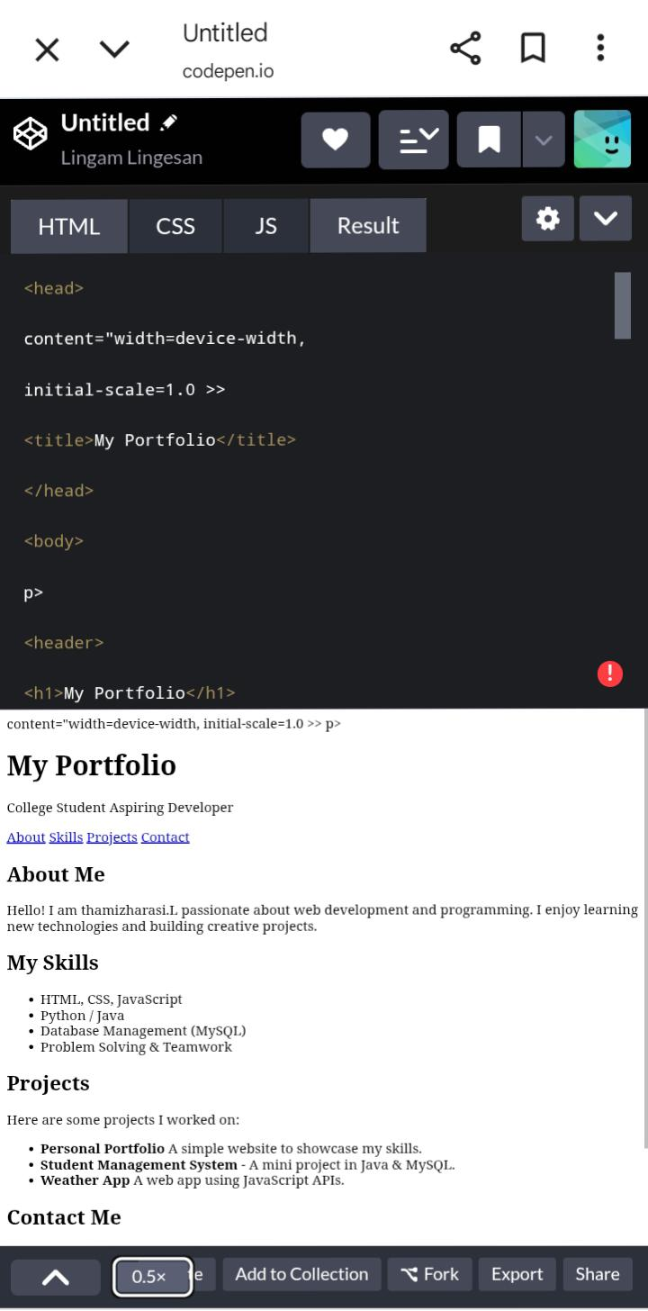
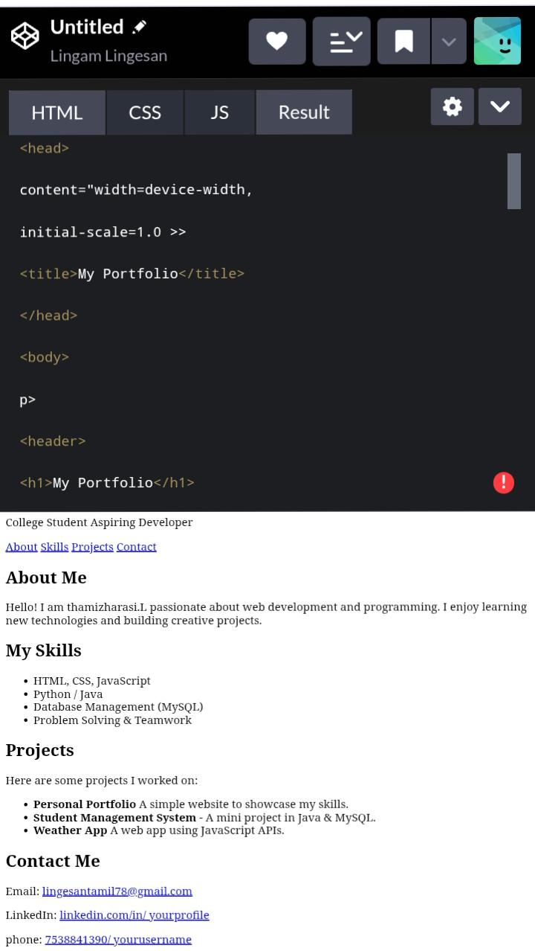
RESULTS AND SCREENSHOTS
9

Slide 10

ABOUT ME !!
Hello! I am Thamizharasi L, a Computer Science student and an aspiring developer. I am passionate about web development, programming, and problem-solving. I enjoy exploring new technologies and building projects that enhance my skills. My goal is to grow as an IT professional and create meaningful contributions through my work

Slide 11

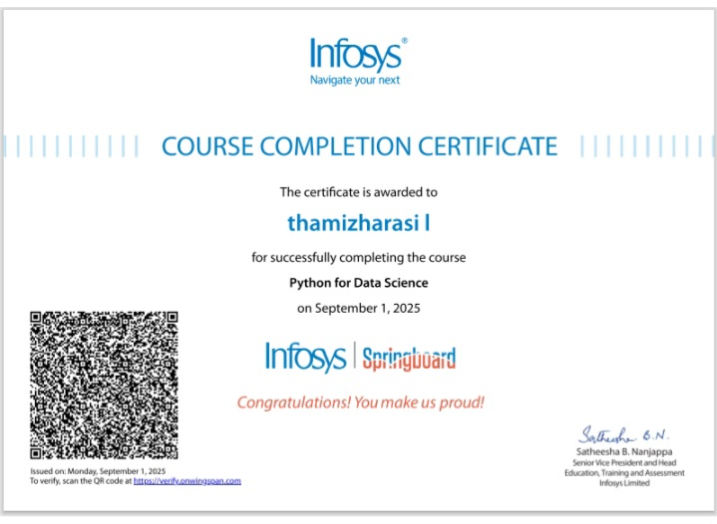


SKILLS
I have a strong foundation in web development and programming. I am skilled in HTML, CSS, JavaScript, Java, Python, and MySQL. Along with technical skills, I possess problem-solving and teamwork abilities. I have also completed certified courses from Infosys Springboard and Simplilearn, which helped me improve my technical knowledge and practical skills

Slide 12



CONTACT DETAILS
1.EMAIL NO : lingesantamil78@gamil. Com
2.CONTANCT NO : 7538841390
3.NM ID : asunm293222403865

Slide 13

CONCLUSION
This project gave me the opportunity to design and build my own portfolio website using HTML, CSS, and JavaScript. It not only helped me showcase my skills and projects in a professional way but also improved my confidence in web development. The website is simple, responsive, and easy to use, and I believe it will be very useful for placements, internships, and future opportunities
THANKING YOU
13

